Slide 1
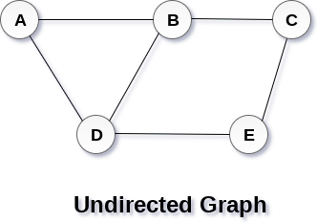
Graph
A graph can be defined as group of vertices and edges that are used to connect these vertices. A graph can be seen as a cyclic tree, where the vertices (Nodes) maintain any complex relationship among them instead of having parent child relationship.
Definition
A graph G can be defined as an ordered set G(V, E) where V(G) represents the set of vertices and E(G) represents the set of edges which are used to connect these vertices.
A Graph G(V, E) with 5 vertices (A, B, C, D, E) and six edges ((A,B), (B,C), (C,E), (E,D), (D,B), (D,A)) is shown in the following figure.
Directed and Undirected Graph
A graph can be directed or undirected. However, in an undirected graph, edges are not associated with the directions with them. An undirected graph is shown in the above figure since its edges are not attached with any of the directions. If an edge exists between vertex A and B then the vertices can be traversed from B to A as well as A to B.
In a directed graph, edges form an ordered pair. Edges represent a specific path from some vertex A to another vertex B. Node A is called initial node while node B is called terminal node.

Slide 2
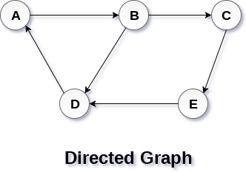
A directed graph is shown in the following figure.
Graph Terminology
Path
A path can be defined as the sequence of nodes that are followed in order to reach some terminal node V from the initial node U.
Closed Path
A path will be called as closed path if the initial node is same as terminal node. A path will be closed path if V0=VN.
Simple Path
If all the nodes of the graph are distinct with an exception V0=VN, then such path P is called as closed simple path.
Cycle
A cycle can be defined as the path which has no repeated edges or vertices except the first and last vertices.
Connected Graph
A connected graph is the one in which some path exists between every two vertices (u, v) in V. There are no isolated nodes in connected graph.

Slide 3
Complete Graph
A complete graph is the one in which every node is connected with all other nodes. A complete graph contain n(n-1)/2 edges where n is the number of nodes in the graph.
Weighted Graph
In a weighted graph, each edge is assigned with some data such as length or weight. The weight of an edge e can be given as w(e) which must be a positive (+) value indicating the cost of traversing the edge.
Digraph
A digraph is a directed graph in which each edge of the graph is associated with some direction and the traversing can be done only in the specified direction.
Loop
An edge that is associated with the similar end points can be called as Loop.
Adjacent Nodes
If two nodes u and v are connected via an edge e, then the nodes u and v are called as neighbours or adjacent nodes.
Degree of the Node
A degree of a node is the number of edges that are connected with that node. A node with degree 0 is called as isolated node.
Comparison between Adjacency List and Adjacency Matrix representation of Graph
A Graph is a non-linear data structure consisting of nodes and edges. The nodes are
sometimes also referred to as vertices and the edges are lines or arcs that connect any two nodes in the graph. In this article, we will understand the difference between the ways of representation of the graph.
A graph can be represented in mainly two ways. They are:

Slide 4
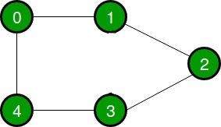
Adjacency List: An Adjacency list is an array consisting of the address of all the linked lists. The first node of the linked list represents the vertex and the
remaining lists connected to this node represents the vertices to which this node is connected. This representation can also be used to represent a weighted graph. The
linked list can slightly be changed to even store the weight of the edge.
Adjacency Matrix: Adjacency Matrix is a 2D array of size V x V where V is the number of vertices in a graph. Let the 2D array be adj[][], a slot adj[i][j] = 1 indicates that there is an edge from vertex i to vertex j. Adjacency matrix for undirected graph is always symmetric. Adjacency Matrix is also used to represent weighted graphs. If adj[i][j] = w, then there is an edge from vertex i to vertex j with weight w.
Let us consider a graph to understand the adjacency list and adjacency matrix representation. Let the undirected graph be:
The following graph is represented in the above representations as:
1. Adjacency Matrix: In the adjacency matrix representation, a graph is represented in the form of a two-dimensional array. The size of the array is V x V, where V is the set of vertices. The following image represents the adjacency matrix representation:

Slide 5
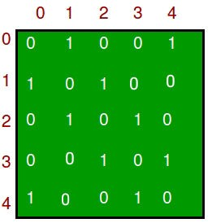
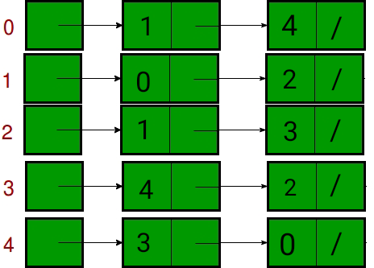
1. Adjacency List: In the adjacency list representation, a graph is represented as an array of linked list. The index of the array represents a vertex and each element in its linked list represents the vertices that form an edge with the vertex. The following image represents the adjacency list representation:
The following table describes the difference between the adjacency matrix and the adjacency list:

Slide 6
Operations | Adjacency Matrix | Adjacency List In this representation, for every vertex
 |  | we store its neighbours. In the worst
 |  | case, if a graph is connected O(V) is
 | This representation makes use | required for a vertex and O(E) is
 | of VxV matrix, so space | required for storing neighbours
Storage Space | required in worst case is O(|V|²). | corresponding to every vertex .Thus, overall space complexity is O(|V|+|E|).
 | In order to add a new vertex to
 | VxV matrix the storage must be increases to (|V|+1)². To achieve | There are two pointers in adjacency list first points to the front node and
 | this we need to copy the whole | the other one points to the rear
Adding a vertex | matrix. Therefore the complexity is O(|V|²). | node.Thus insertion of a vertex can be done directly in O(1) time.
 |  | Similar to insertion of vertex here also
 | To add an edge say from i to j, | two pointers are used pointing to the
Adding an | matrix[i][j] = 1 which | rear and front of the list. Thus, an edge
edge | requires O(1) time. | can be inserted in O(1)time.
 | In order to remove a vertex | In order to remove a vertex, we need
 | from V*V matrix the storage must be decreased to |V|² from (|V|+1)². To achieve this we | to search for the vertex which will require O(|V|) time in worst case, after this we need to traverse the edges and
 | need to copy the whole matrix. | in worst case it will require O(|E|)
Removing a vertex | Therefore the complexity is O(|V|²). | time.Hence, total time complexity is O(|V|+|E|).
 |  | To remove an edge traversing through
 |  | the edges is required and in worst case
 | To remove an edge say from i to | we need to traverse through all the
Removing | j, matrix[i][j] = 0 which | edges.Thus, the time complexity
an edge | requires O(1) time. | is O(|E|).
 | In order to find for an existing | In an adjacency list every vertex is
 | edge the content of matrix | associated with a list of adjacent
 | needs to be checked. Given two | vertices. For a given graph, in order to
 | vertices say i and j matrix[i][j] | check for an edge we need to check
Querying | can be checked in O(1) time. | for vertices adjacent to given vertex. A

Slide 7
Operations | Adjacency Matrix | Adjacency List vertex can have at most O(|V|)
 |  | neighbours and in worst can we would
 |  | have to check for every adjacent
 |  | vertex. Therefore, time complexity
 |  | is O(|V|) .
Graph representation
In this article, we will discuss the ways to represent the graph. By Graph representation, we simply mean the technique to be used to store some graph into the computer's memory.
A graph is a data structure that consist a sets of vertices (called nodes) and edges. There are two ways to store Graphs into the computer's memory:
Sequential representation (or, Adjacency matrix representation)
Linked list representation (or, Adjacency list representation)
In sequential representation, an adjacency matrix is used to store the graph. Whereas in linked list representation, there is a use of an adjacency list to store the graph.
In this tutorial, we will discuss each one of them in detail.
Now, let's start discussing the ways of representing a graph in the data structure.
Sequential representation
In sequential representation, there is a use of an adjacency matrix to represent the mapping between vertices and edges of the graph. We can use an adjacency matrix to represent the undirected graph, directed graph, weighted directed graph, and weighted undirected graph.
If adj[i][j] = w, it means that there is an edge exists from vertex i to vertex j with weight w.
An entry Aij in the adjacency matrix representation of an undirected graph G will be 1 if an edge exists between Vi and Vj. If an Undirected Graph G consists of n vertices, then the adjacency matrix for that graph is n x n, and the matrix A = [aij] can be defined as -
aij = 1 {if there is a path exists from Vi to Vj} aij = 0 {Otherwise}

Slide 8
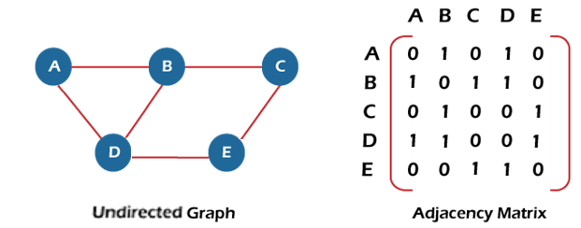
It means that, in an adjacency matrix, 0 represents that there is no association exists between the nodes, whereas 1 represents the existence of a path between two edges.
If there is no self-loop present in the graph, it means that the diagonal entries of the adjacency matrix will be 0.
Now, let's see the adjacency matrix representation of an undirected graph.
In the above figure, an image shows the mapping among the vertices (A, B, C, D, E), and this mapping is represented by using the adjacency matrix.
There exist different adjacency matrices for the directed and undirected graph. In a directed graph, an entry Aij will be 1 only when there is an edge directed from Vi to Vj.
Adjacency matrix for a directed graph
In a directed graph, edges represent a specific path from one vertex to another vertex. Suppose a path exists from vertex A to another vertex B; it means that node A is the initial node, while node B is the terminal node.
Consider the below-directed graph and try to construct the adjacency matrix of it.

Slide 9
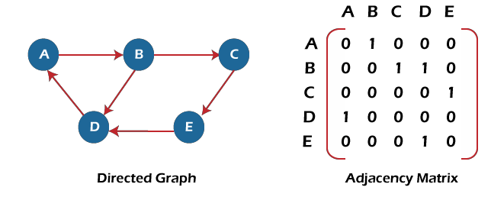

In the above graph, we can see there is no self-loop, so the diagonal entries of the adjacent matrix are 0.
Adjacency matrix for a weighted directed graph
It is similar to an adjacency matrix representation of a directed graph except that instead of using the '1' for the existence of a path, here we have to use the weight associated with the edge. The weights on the graph edges will be represented as the entries of the adjacency matrix. We can understand it with the help of an example. Consider the below graph and its adjacency matrix representation. In the representation, we can see that the weight associated with the edges is represented as the entries in the adjacency matrix.
In the above image, we can see that the adjacency matrix representation of the weighted directed graph is different from other representations. It is because, in this representation, the non-zero values are replaced by the actual weight assigned to the edges.

Slide 10
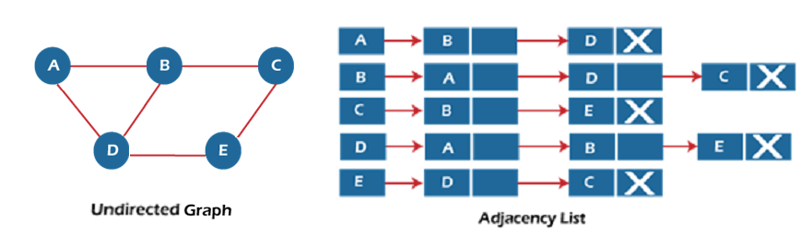
Adjacency matrix is easier to implement and follow. An adjacency matrix can be used when the graph is dense and a number of edges are large.
Though, it is advantageous to use an adjacency matrix, but it consumes more space. Even if the graph is sparse, the matrix still consumes the same space.
Linked list representation
An adjacency list is used in the linked representation to store the Graph in the computer's memory. It is efficient in terms of storage as we only have to store the values for edges.
Let's see the adjacency list representation of an undirected graph.
In the above figure, we can see that there is a linked list or adjacency list for every node of the graph. From vertex A, there are paths to vertex B and vertex D. These nodes are linked to nodes A in the given adjacency list.
An adjacency list is maintained for each node present in the graph, which stores the node value and a pointer to the next adjacent node to the respective node. If all the adjacent nodes are traversed, then store the NULL in the pointer field of the last node of the list.
The sum of the lengths of adjacency lists is equal to twice the number of edges present in an undirected graph.
Now, consider the directed graph, and let's see the adjacency list representation of that graph.

Slide 11
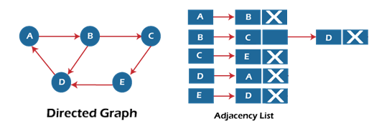
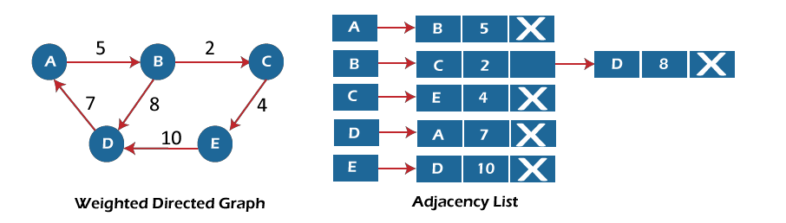
For a directed graph, the sum of the lengths of adjacency lists is equal to the number of edges present in the graph.
Now, consider the weighted directed graph, and let's see the adjacency list representation of that graph.
In the case of a weighted directed graph, each node contains an extra field that is called the weight of the node.
In an adjacency list, it is easy to add a vertex. Because of using the linked list, it also saves space.
Implementation of adjacency matrix representation of Graph
Now, let's see the implementation of adjacency matrix representation of graph in C.
In this program, there is an adjacency matrix representation of an undirected graph. It means that if there is an edge exists from vertex A to vertex B, there will also an edge exists from vertex B to vertex A.
Here, there are four vertices and five edges in the graph that are non-directed.

Slide 12
1. /* Adjacency Matrix representation of an undirected graph in C */ 2.
3.
4.
5.
6.
7.
8.
9.
10.
11.
#include <stdio.h>
#define V 4 /* number of vertices in the graph */
/* function to initialize the matrix to zero */
void init(int arr[][V]) {
int i, j;
for (i = 0; i < V; i++) for (j = 0; j < V; j++) arr[i][j] = 0;
12. } 13.
/* function to add edges to the graph */
void insertEdge(int arr[][V], int i, int j) { 16. arr[i][j] = 1;
17. arr[j][i] = 1;
18. } 19.
/* function to print the matrix elements */
void printAdjMatrix(int arr[][V]) {
int i, j;
23. for (i = 0; i < V; i++) {
24. printf("%d: ", i);
25. for (j = 0; j < V; j++) {
26. printf("%d ", arr[i][j]);
27. }
28. printf("\n");
29. }

Slide 13

30. } 31.
32. int main() {
33. int adjMatrix[V][V]; 34.
35.
36.
37.
38.
39.
40.
41.
42.
43.
44.
45. }
init(adjMatrix); insertEdge(adjMatrix, 0, 1);
insertEdge(adjMatrix, 0, 2);
insertEdge(adjMatrix, 1, 2);
insertEdge(adjMatrix, 2, 0);
insertEdge(adjMatrix, 2, 3);
printAdjMatrix(adjMatrix);
return 0;
Output:
After the execution of the above code, the output will be -
Implementation of adjacency list representation of Graph
Now, let's see the implementation of adjacency list representation of graph in C.
In this program, there is an adjacency list representation of an undirected graph. It means that if there is an edge exists from vertex A to vertex B, there will also an edge exists from vertex B to vertex A.

Slide 14
/* Adjacency list representation of a graph in C */
#include <stdio.h>
#include <stdlib.h> 4.
5.
6.
7.
8.
9.
10.
/* structure to represent a node of adjacency list */
struct AdjNode {
int dest;
struct AdjNode* next;
};
/* structure to represent an adjacency list */
struct AdjList {
struct AdjNode* head; 14. };
15.
/* structure to represent the graph */
struct Graph {
int V; /*number of vertices in the graph*/
struct AdjList* array; 20. };
21.
22.
23. struct AdjNode* newAdjNode(int dest)
24. {
struct AdjNode* newNode = (struct AdjNode*)malloc(sizeof(struct AdjNode));
newNode->dest = dest;
newNode->next = NULL;
return newNode;
29. } 30.
31. struct Graph* createGraph(int V)
32. {
struct Graph* graph = (struct Graph*)malloc(sizeof(struct Graph));
graph->V = V;

Slide 15
35. graph->array = (struct AdjList*)malloc(V * sizeof(struct AdjList)); 36.
37.
38.
39.
40.
41.
42. } 43.
/* Initialize each adjacency list as empty by making head as NULL */
int i;
for (i = 0; i < V; ++i)
graph->array[i].head = NULL;
return graph;
/* function to add an edge to an undirected graph */
void addEdge(struct Graph* graph, int src, int dest)
46. {
/* Add an edge from src to dest. The node is added at the beginning */
struct AdjNode* check = NULL;
struct AdjNode* newNode = newAdjNode(dest); 50.
51.
52.
53.
54.
55.
56.
57.
58.
59.
60.
61.
62.
63. } 64.
65.
66.
67.
68.
if (graph->array[src].head == NULL) { newNode->next = graph->array[src].head; graph->array[src].head = newNode;
}
else {
check = graph->array[src].head;
while (check->next != NULL) { check = check->next;
}
// graph->array[src].head = newNode; check->next = newNode;
/* Since graph is undirected, add an edge from dest to src also */ newNode = newAdjNode(src);
if (graph->array[dest].head == NULL) { newNode->next = graph->array[dest].head;

Slide 16
69.
70. }
else {
check = graph->array[dest].head;
while (check->next != NULL) {
check = check->next;
75. }
76. check->next = newNode;
77. }
78. }
graph->array[dest].head = newNode;
/* function to print the adjacency list representation of graph*/
void print(struct Graph* graph)
81. {
int v;
for (v = 0; v < graph->V; ++v) {
struct AdjNode* pCrawl = graph->array[v].head;
printf("\n The Adjacency list of vertex %d is: \n head ", v);
while (pCrawl) {
printf("-> %d", pCrawl->dest);
pCrawl = pCrawl->next;
89. }
90. printf("\n");
91. }
92. } 93.
94. int main()
95. { 96.
int V = 4;
struct Graph* g = createGraph(V);
addEdge(g, 0, 1);
addEdge(g, 0, 3);
addEdge(g, 1, 2);
addEdge(g, 1, 3);

Slide 17
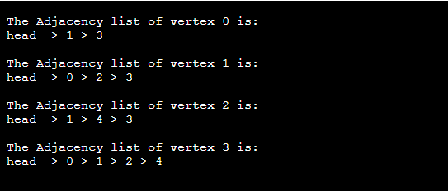
103.
104.
105.
106.
107.
108.
addEdge(g, 2, 4);
addEdge(g, 2, 3);
addEdge(g, 3, 4); print(g);
return 0;
}
Output:
In the output, we will see the adjacency list representation of all the vertices of the graph. After the execution of the above code, the output will be –
Spanning tree
In this article, we will discuss the spanning tree and the minimum spanning tree. But before moving directly towards the spanning tree, let's first see a brief description of the graph and its types.
Graph
A graph can be defined as a group of vertices and edges to connect these vertices. The types of graphs are given as follows -
o Undirected graph: An undirected graph is a graph in which all the edges do not point to any particular direction, i.e., they are not unidirectional; they are bidirectional. It can also be defined as a graph with a set of V vertices and a set of E edges, each edge connecting two different vertices.

Slide 18
Connected graph: A connected graph is a graph in which a path always exists from a vertex to any other vertex. A graph is connected if we can reach any vertex from any other vertex by following edges in either direction.
Directed graph: Directed graphs are also known as digraphs. A graph is a directed graph (or digraph) if all the edges present between any vertices or nodes of the graph are directed or have a defined direction.
Now, let's move towards the topic spanning tree.
What is a spanning tree?
A spanning tree can be defined as the subgraph of an undirected connected graph. It includes all the vertices along with the least possible number of edges. If any vertex is missed, it is not a spanning tree. A spanning tree is a subset of the graph that does not have cycles, and it also cannot be disconnected.
A spanning tree consists of (n-1) edges, where 'n' is the number of vertices (or nodes). Edges of the spanning tree may or may not have weights assigned to them. All the possible spanning trees created from the given graph G would have the same number of vertices, but the number of edges in the spanning tree would be equal to the number of vertices in the given graph minus 1.
A complete undirected graph can have n^{n-2} number of spanning trees where n is the number of vertices in the graph. Suppose, if n = 5, the number of maximum possible spanning trees would be 5⁵⁻² = 125.
Applications of the spanning tree
Basically, a spanning tree is used to find a minimum path to connect all nodes of the graph. Some of the common applications of the spanning tree are listed as follows -
Cluster Analysis
Civil network planning
Computer network routing protocol
Now, let's understand the spanning tree with the help of an example.

Slide 19
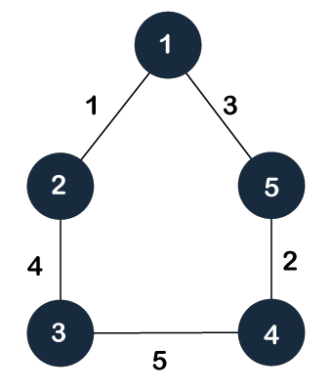
Example of Spanning tree
Suppose the graph be -
As discussed above, a spanning tree contains the same number of vertices as the graph, the number of vertices in the above graph is 5; therefore, the spanning tree will contain 5 vertices. The edges in the spanning tree will be equal to the number of vertices in the graph minus 1. So, there will be 4 edges in the spanning tree.
Some of the possible spanning trees that will be created from the above graph are given as follows -

Slide 20
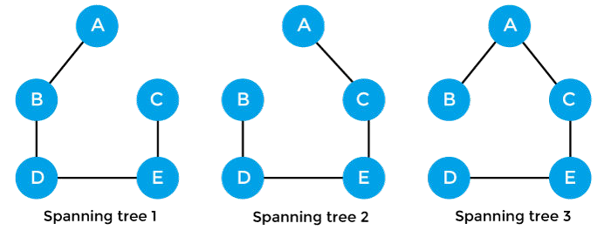
Properties of spanning-tree
Some of the properties of the spanning tree are given as follows -
There can be more than one spanning tree of a connected graph G.
A spanning tree does not have any cycles or loop.
A spanning tree is minimally connected, so removing one edge from the tree will make the graph disconnected.
A spanning tree is maximally acyclic, so adding one edge to the tree will create a loop.
There can be a maximum n^{n-2} number of spanning trees that can be created from a complete graph.
A spanning tree has n-1 edges, where 'n' is the number of nodes.
If the graph is a complete graph, then the spanning tree can be constructed by removing maximum (e-n+1) edges, where 'e' is the number of edges and 'n' is the number of vertices.
So, a spanning tree is a subset of connected graph G, and there is no spanning tree of a disconnected graph.
Minimum Spanning tree
A minimum spanning tree can be defined as the spanning tree in which the sum of the weights of the edge is minimum. The weight of the spanning tree is the sum of the weights

Slide 21
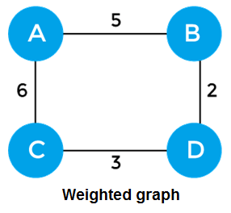
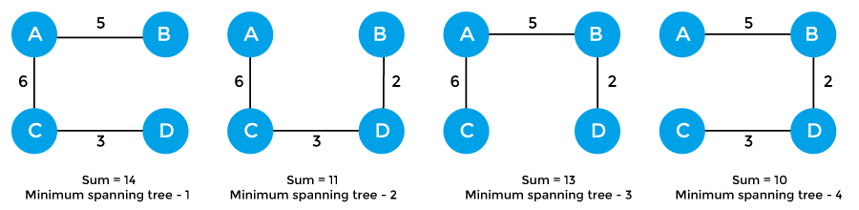
given to the edges of the spanning tree. In the real world, this weight can be considered as the distance, traffic load, congestion, or any random value.
Example of minimum spanning tree
Let's understand the minimum spanning tree with the help of an example.
The sum of the edges of the above graph is 16. Now, some of the possible spanning trees created from the above graph are -
So, the minimum spanning tree that is selected from the above spanning trees for the given weighted graph is -

Slide 22
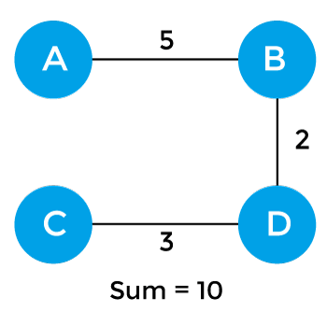
Applications of minimum spanning tree
The applications of the minimum spanning tree are given as follows -
Minimum spanning tree can be used to design water-supply networks, telecommunication networks, and electrical grids.
It can be used to find paths in the map.
Algorithms for Minimum spanning tree
A minimum spanning tree can be found from a weighted graph by using the algorithms given below -
Prim's Algorithm
Kruskal's Algorithm
Let's see a brief description of both of the algorithms listed above.
Prim's algorithm - It is a greedy algorithm that starts with an empty spanning tree. It is used to find the minimum spanning tree from the graph. This algorithm finds the subset of edges that includes every vertex of the graph such that the sum of the weights of the edges can be minimized.

Slide 23
Kruskal's algorithm - This algorithm is also used to find the minimum spanning tree for a connected weighted graph. Kruskal's algorithm also follows greedy approach, which finds an optimum solution at every stage instead of focusing on a global optimum.
Prim's Algorithm
In this article, we will discuss the prim's algorithm. Along with the algorithm, we will also see the complexity, working, example, and implementation of prim's algorithm.
Before starting the main topic, we should discuss the basic and important terms such as spanning tree and minimum spanning tree.
Spanning tree - A spanning tree is the subgraph of an undirected connected graph.
Minimum Spanning tree - Minimum spanning tree can be defined as the spanning tree in which the sum of the weights of the edge is minimum. The weight of the spanning tree is the sum of the weights given to the edges of the spanning tree.
Now, let's start the main topic.
Prim's Algorithm is a greedy algorithm that is used to find the minimum spanning tree from a graph. Prim's algorithm finds the subset of edges that includes every vertex of the graph such that the sum of the weights of the edges can be minimized.
Prim's algorithm starts with the single node and explores all the adjacent nodes with all the connecting edges at every step. The edges with the minimal weights causing no cycles in the graph got selected.
How does the prim's algorithm work?
Prim's algorithm is a greedy algorithm that starts from one vertex and continue to add the edges with the smallest weight until the goal is reached. The steps to implement the prim's algorithm are given as follows -
First, we have to initialize an MST with the randomly chosen vertex.
Now, we have to find all the edges that connect the tree in the above step with the new vertices. From the edges found, select the minimum edge and add it to the tree.
Repeat step 2 until the minimum spanning tree is formed.
The applications of prim's algorithm are -

Slide 24
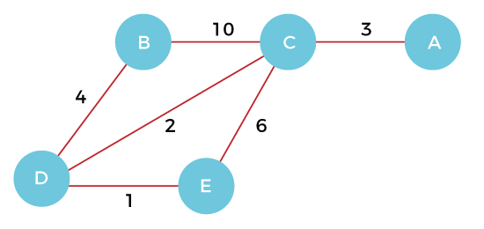

Prim's algorithm can be used in network designing.
It can be used to make network cycles.
It can also be used to lay down electrical wiring cables.
Example of prim's algorithm
Now, let's see the working of prim's algorithm using an example. It will be easier to understand the prim's algorithm using an example.
Suppose, a weighted graph is -
Step 1 - First, we have to choose a vertex from the above graph. Let's choose B.
Step 2 - Now, we have to choose and add the shortest edge from vertex B. There are two edges from vertex B that are B to C with weight 10 and edge B to D with weight 4. Among the edges, the edge BD has the minimum weight. So, add it to the MST.

Slide 25
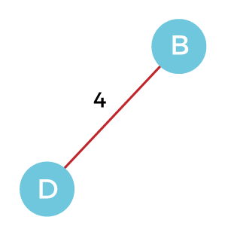
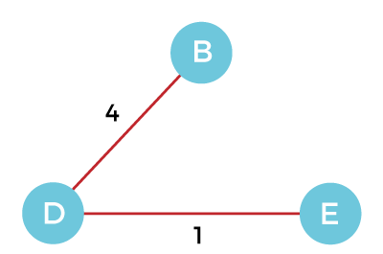
Step 3 - Now, again, choose the edge with the minimum weight among all the other edges. In this case, the edges DE and CD are such edges. Add them to MST and explore the adjacent of C, i.e., E and A. So, select the edge DE and add it to the MST.
Step 4 - Now, select the edge CD, and add it to the MST.

Slide 26
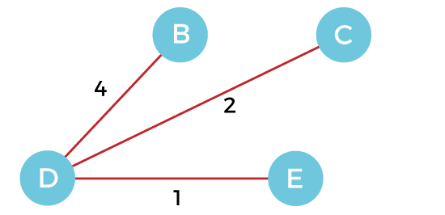
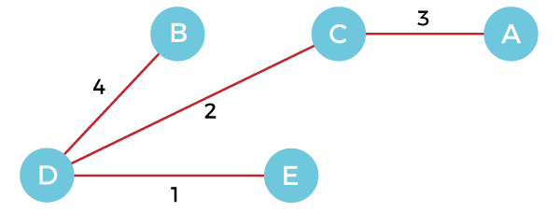
Step 5 - Now, choose the edge CA. Here, we cannot select the edge CE as it would create a cycle to the graph. So, choose the edge CA and add it to the MST.
So, the graph produced in step 5 is the minimum spanning tree of the given graph. The cost of the MST is given below -
Cost of MST = 4 + 2 + 1 + 3 = 10 units.
Algorithm
1. Step 1: Select a starting vertex
Step 2: Repeat Steps 3 and 4 until there are fringe vertices
Step 3: Select an edge 'e' connecting the tree vertex and fringe vertex that has minimum weight
Step 4: Add the selected edge and the vertex to the minimum spanning tree T

Slide 27
[END OF LOOP]
Step 5: EXIT
Complexity of Prim's algorithm
Now, let's see the time complexity of Prim's algorithm. The running time of the prim's algorithm depends upon using the data structure for the graph and the ordering of edges. Below table shows some choices -
o Time Complexity
Data structure used for the minimum edge weight Time Complexity
Adjacency matrix, linear searching | O(|V|²)
Adjacency list and binary heap | O(|E| log |V|)
Adjacency list and Fibonacci heap | O(|E|+ |V| log |V|)
Prim's algorithm can be simply implemented by using the adjacency matrix or adjacency list graph representation, and to add the edge with the minimum weight requires the linearly searching of an array of weights. It requires O(|V|²) running time. It can be improved further by using the implementation of heap to find the minimum weight edges in the inner loop of the algorithm.
The time complexity of the prim's algorithm is O(E logV) or O(V logV), where E is the no. of edges, and V is the no. of vertices.
Implementation of Prim's algorithm
Now, let's see the implementation of prim's algorithm.
Program: Write a program to implement prim's algorithm in C language.
#include <stdio.h>
#include <limits.h>
#define vertices 5 /*Define the number of vertices in the graph*/

Slide 28
/* create minimum_key() method for finding the vertex that has minimum key- value and that is not added in MST yet */
int minimum_key(int k[], int mst[]) 6. {
7. int minimum = INT_MAX, min,i; 8.
9.
10.
11.
12.
13.
/*iterate over all vertices to find the vertex with minimum key-value*/
for (i = 0; i < vertices; i++)
if (mst[i] == 0 && k[i] < minimum ) minimum = k[i], min = i;
return min;
14. }
/* create prim() method for constructing and printing the MST.
The g[vertices][vertices] is an adjacency matrix that defines the graph for MST.*/
void prim(int g[vertices][vertices])
18. {
/* create array of size equal to total number of vertices for storing the MST*/
int parent[vertices];
/* create k[vertices] array for selecting an edge having minimum weight*/
int k[vertices];
int mst[vertices];
int i, count,edge,v; /*Here 'v' is the vertex*/
for (i = 0; i < vertices; i++)
26. {
27. k[i] = INT_MAX;
28. mst[i] = 0;
29. }
k[0] = 0; /*It select as first vertex*/
parent[0] = -1; /* set first value of parent[] array to -1 to make it root of MST*/
for (count = 0; count < vertices-1; count++)
33. {
34. /*select the vertex having minimum key and that is not added in the MST yet from the set o f vertices*/
edge = minimum_key(k, mst);
35.

Slide 29
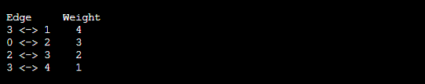
36.
37.
38.
39.
40.
41.
42.
43.
44. }
/*Print the constructed Minimum spanning tree*/
printf("\n Edge \t Weight\n");
for (i = 1; i < vertices; i++)
printf(" %d <-> %d %d \n", parent[i], i, g[i][parent[i]]); 49.
50. }
mst[edge] = 1;
for (v = 0; v < vertices; v++)
{
if (g[edge][v] && mst[v] == 0 && g[edge][v] < k[v])
{
parent[v] = edge, k[v] = g[edge][v];
}
}
51. int main()
52. {
53. int g[vertices][vertices] = {{0, 0, 3, 0, 0}, 54. {0, 0, 10, 4, 0},
55. {3, 10, 0, 2, 6},
56. {0, 4, 2, 0, 1},
57. {0, 0, 6, 1, 0},
58. };
prim(g);
return 0;
61. }
Output

Slide 30
Kruskal's Algorithm
In this article, we will discuss Kruskal's algorithm. Here, we will also see the complexity, working, example, and implementation of the Kruskal's algorithm.
But before moving directly towards the algorithm, we should first understand the basic terms such as spanning tree and minimum spanning tree.
Spanning tree - A spanning tree is the subgraph of an undirected connected graph.
Minimum Spanning tree - Minimum spanning tree can be defined as the spanning tree in which the sum of the weights of the edge is minimum. The weight of the spanning tree is the sum of the weights given to the edges of the spanning tree.
Now, let's start with the main topic.
Kruskal's Algorithm is used to find the minimum spanning tree for a connected weighted graph. The main target of the algorithm is to find the subset of edges by using which we can traverse every vertex of the graph. It follows the greedy approach that finds an optimum solution at every stage instead of focusing on a global optimum.
How does Kruskal's algorithm work?
In Kruskal's algorithm, we start from edges with the lowest weight and keep adding the edges until the goal is reached. The steps to implement Kruskal's algorithm are listed as follows -
First, sort all the edges from low weight to high.
Now, take the edge with the lowest weight and add it to the spanning tree. If the edge to be added creates a cycle, then reject the edge.
Continue to add the edges until we reach all vertices, and a minimum spanning tree is created.
The applications of Kruskal's algorithm are -
Kruskal's algorithm can be used to layout electrical wiring among cities.
It can be used to lay down LAN connections.

Slide 31
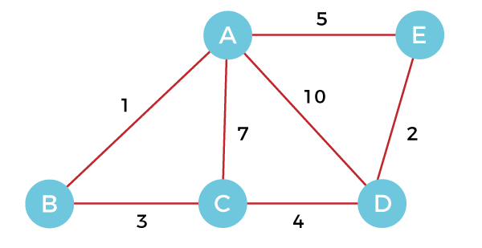
Example of Kruskal's algorithm
Now, let's see the working of Kruskal's algorithm using an example. It will be easier to understand Kruskal's algorithm using an example.
Suppose a weighted graph is -
The weight of the edges of the above graph is given in the below table -
Edge | AB | AC | AD | AE | BC | CD | DE
Weight | 1 | 7 | 10 | 5 | 3 | 4 | 2
Now, sort the edges given above in the ascending order of their weights.
Edge | AB | DE | BC | CD | AE | AC | AD
Weight | 1 | 2 | 3 | 4 | 5 | 7 | 10
Now, let's start constructing the minimum spanning tree.
Step 1 - First, add the edge AB with weight 1 to the MST.

Slide 32
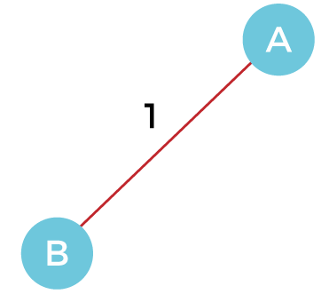
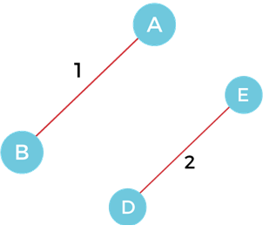
Step 2 - Add the edge DE with weight 2 to the MST as it is not creating the cycle.
Step 3 - Add the edge BC with weight 3 to the MST, as it is not creating any cycle or loop.

Slide 33
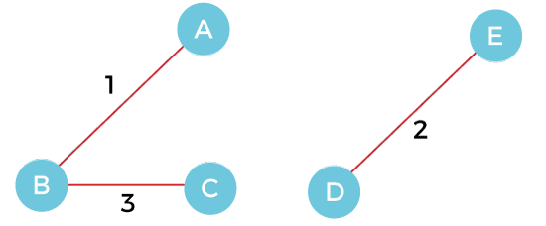
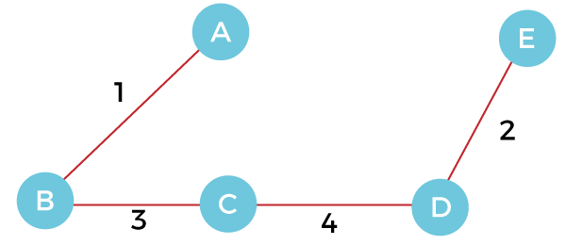
Step 4 - Now, pick the edge CD with weight 4 to the MST, as it is not forming the cycle.
Step 5 - After that, pick the edge AE with weight 5. Including this edge will create the cycle, so discard it.
Step 6 - Pick the edge AC with weight 7. Including this edge will create the cycle, so discard it.
Step 7 - Pick the edge AD with weight 10. Including this edge will also create the cycle, so discard it.
So, the final minimum spanning tree obtained from the given weighted graph by using Kruskal's algorithm is -

Slide 34
The cost of the MST is = AB + DE + BC + CD = 1 + 2 + 3 + 4 = 10.
Now, the number of edges in the above tree equals the number of vertices minus 1. So, the algorithm stops here.
Algorithm
Step 1: Create a forest F in such a way that every vertex of the graph is a separate tree.
Step 2: Create a set E that contains all the edges of the graph.
Step 3: Repeat Steps 4 and 5 while E is NOT EMPTY and F is not spanning
Step 4: Remove an edge from E with minimum weight
Step 5: IF the edge obtained in Step 4 connects two different trees, then add it to the forest F
(for combining two trees into one tree).
ELSE
Discard the edge
Step 6: END
Complexity of Kruskal's algorithm
Now, let's see the time complexity of Kruskal's algorithm.

Slide 35
o Time Complexity
The time complexity of Kruskal's algorithm is O(E logE) or O(V logV), where E is the no. of edges, and V is the no. of vertices.
Implementation of Kruskal's algorithm
Now, let's see the implementation of kruskal's algorithm.
Program: Write a program to implement kruskal's algorithm in C++.
#include <iostream>
#include <algorithm>
using namespace std;
const int MAX = 1e4 + 5;
int id[MAX], nodes, edges;
pair <long long, pair<int, int> > p[MAX];
void init() 8. {
for(int i = 0;i < MAX;++i)
id[i] = i;
11. }
12. int root(int x)
13. {
14. while(id[x] != x)
15. {
id[x] = id[id[x]];
x = id[x];
18. }
19. return x;
20. }

Slide 36
21. void union1(int x, int y)
22. {
int p = root(x);
int q = root(y);
id[p] = id[q];
26. }
27. long long kruskal(pair<long long, pair<int, int> > p[])
28. {
int x, y;
long long cost, minimumCost = 0;
for(int i = 0;i < edges;++i)
32. {
x = p[i].second.first;
y = p[i].second.second;
cost = p[i].first;
if(root(x) != root(y))
37. {
minimumCost += cost;
union1(x, y);
40. }
41. }
42. return minimumCost;
43. }
44. int main()
45. {
int x, y;
long long weight, cost, minimumCost;
init();
cout <<"Enter Nodes and edges";
cin >> nodes >> edges;
for(int i = 0;i < edges;++i)
52. {
cout<<"Enter the value of X, Y and edges";
cin >> x >> y >> weight;

Slide 37
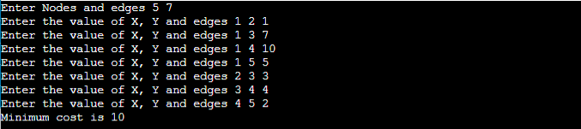
55.
56. }
sort(p, p + edges);
minimumCost = kruskal(p);
cout <<"Minimum cost is "<< minimumCost << endl;
return 0;
61. }
p[i] = make_pair(weight, make_pair(x, y));
Output
BFS algorithm
In this article, we will discuss the BFS algorithm in the data structure. Breadth-first search is a graph traversal algorithm that starts traversing the graph from the root node and explores all the neighboring nodes. Then, it selects the nearest node and explores all the unexplored nodes. While using BFS for traversal, any node in the graph can be considered as the root node.
There are many ways to traverse the graph, but among them, BFS is the most commonly used approach. It is a recursive algorithm to search all the vertices of a tree or graph data structure. BFS puts every vertex of the graph into two categories - visited and non-visited. It selects a single node in a graph and, after that, visits all the nodes adjacent to the selected node.
Applications of BFS algorithm
The applications of breadth-first-algorithm are given as follows -
o BFS can be used to find the neighboring locations from a given source location.

Slide 38
In a peer-to-peer network, BFS algorithm can be used as a traversal method to find all the neighboring nodes. Most torrent clients, such as BitTorrent, uTorrent, etc. employ this process to find "seeds" and "peers" in the network.
BFS can be used in web crawlers to create web page indexes. It is one of the main algorithms that can be used to index web pages. It starts traversing from the source page and follows the links associated with the page. Here, every web page is considered as a node in the graph.
BFS is used to determine the shortest path and minimum spanning tree.
BFS is also used in Cheney's technique to duplicate the garbage collection.
It can be used in ford-Fulkerson method to compute the maximum flow in a flow network.
Algorithm
The steps involved in the BFS algorithm to explore a graph are given as follows -
Step 1: SET STATUS = 1 (ready state) for each node in G
Step 2: Enqueue the starting node A and set its STATUS = 2 (waiting state)
Step 3: Repeat Steps 4 and 5 until QUEUE is empty
Step 4: Dequeue a node N. Process it and set its STATUS = 3 (processed state).
Step 5: Enqueue all the neighbours of N that are in the ready state (whose STATUS = 1) and set
their STATUS = 2 (waiting state)
[END OF LOOP]
Step 6: EXIT
Algorithm:
1. Enqueue starting vertex and print

Slide 39
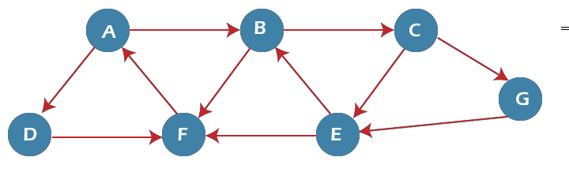
While(q is not empty)
P = dequeue
Enqueue (print) all adjacent vertex of p }
Example of BFS algorithm
Now, let's understand the working of BFS algorithm by using an example. In the example given below, there is a directed graph having 7 vertices.
In the above graph, minimum path 'P' can be found by using the BFS that will start from Node A and end at Node E. The algorithm uses two queues, namely QUEUE1 and QUEUE2. QUEUE1 holds all the nodes that are to be processed, while QUEUE2 holds all the nodes that are processed and deleted from QUEUE1.
Now, let's start examining the graph starting from Node A.
Step 1 - First, add A to queue1 and NULL to queue2.
QUEUE1 = {A}
QUEUE2 = {NULL}
Step 2 - Now, delete node A from queue1 and add it into queue2. Insert all neighbors of node A to queue1.
QUEUE1 = {B, D}
QUEUE2 = {A}
Step 3 - Now, delete node B from queue1 and add it into queue2. Insert all neighbors of node B to queue1.

Slide 40
QUEUE1 = {D, C, F}
QUEUE2 = {A, B}
Step 4 - Now, delete node D from queue1 and add it into queue2. Insert all neighbors of node D to queue1. The only neighbor of Node D is F since it is already inserted, so it will not be inserted again.
QUEUE1 = {C, F}
QUEUE2 = {A, B, D}
Step 5 - Delete node C from queue1 and add it into queue2. Insert all neighbors of node C to queue1.
QUEUE1 = {F, E, G}
QUEUE2 = {A, B, D, C}
Step 5 - Delete node F from queue1 and add it into queue2. Insert all neighbors of node F to queue1. Since all the neighbors of node F are already present, we will not insert them again.
QUEUE1 = {E, G}
QUEUE2 = {A, B, D, C, F}
Step 6 - Delete node E from queue1. Since all of its neighbors have already been added, so we will not insert them again. Now, all the nodes are visited, and the target node E is encountered into queue2.
QUEUE1 = {G}
QUEUE2 = {A, B, D, C, F, E}
Complexity of BFS algorithm
Time complexity of BFS depends upon the data structure used to represent the graph. The time complexity of BFS algorithm is O(V+E), since in the worst case, BFS algorithm explores every node and edge. In a graph, the number of vertices is O(V), whereas the number of edges is O(E).
The space complexity of BFS can be expressed as O(V), where V is the number of vertices.

Slide 41
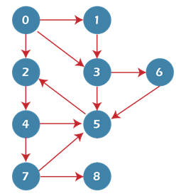
Implementation of BFS algorithm
Now, let's see the implementation of BFS algorithm in java.
In this code, we are using the adjacency list to represent our graph. Implementing the Breadth-First Search algorithm in Java makes it much easier to deal with the adjacency list since we only have to travel through the list of nodes attached to each node once the node is dequeued from the head (or start) of the queue.
In this example, the graph that we are using to demonstrate the code is given as follows
-
import java.io.*;
import java.util.*;
public class BFSTraversal 4. {
5.
6.
7.
8.
9.
10.
11.
12.
13.
private int vertex;
/* total number number of vertices in the graph */
private LinkedList<Integer> adj[]; private Queue<Integer> que; BFSTraversal(int v)
{
vertex = v;
adj = new LinkedList[vertex];
for (int i=0; i<v; i++)
{
/* adjacency list */
/* maintaining a queue */

Slide 42
14.
15.
16.
17. }
18. void insertEdge(int v,int w)
19. { 20.
adj[i] = new LinkedList<>();
}
que = new LinkedList<Integer>();
adj[v].add(w); mple) */
21. }
22. void BFS(int n)
23. { 24.
/* adding an edge to the adjacency list (edges are bidirectional in this exa
boolean nodes[] = new boolean[vertex];
/* initialize boolean array for holding the data
*/
25.
26.
27.
28.
29.
30.
31.
32.
int a = 0; nodes[n]=true; que.add(n);
/* root node is added to the top of the queue */
while (que.size() != 0)
{
n = que.poll(); /* remove the top element of the queue */ System.out.print(n+" "); /* print the top element of the queue */
for (int i = 0; i < adj[n].size(); i++) /* iterate through the linked list and push all neighbor s into queue */
{
a = adj[n].get(i);
if (!nodes[a]) /* only insert nodes into queue if they have not been explored alread
33.
34.
35.
y */
36.
37.
38.
39.
40.
41.
42. }
43. public static void main(String args[])
{
nodes[a] = true; que.add(a);
}
}
}

Slide 43

44. | {
45. |  | BFSTraversal graph = new BFSTraversal(10);
46. |  | graph.insertEdge(0, 1);
47. |  | graph.insertEdge(0, 2);
48. |  | graph.insertEdge(0, 3);
49. |  | graph.insertEdge(1, 3);
50. |  | graph.insertEdge(2, 4);
51. |  | graph.insertEdge(3, 5);
52. |  | graph.insertEdge(3, 6);
53. |  | graph.insertEdge(4, 7);
54. |  | graph.insertEdge(4, 5);
55. |  | graph.insertEdge(5, 2);
56. |  | graph.insertEdge(6, 5);
57. |  | graph.insertEdge(7, 5);
58. |  | graph.insertEdge(7, 8);
59. |  | System.out.println("Breadth First Traversal for the graph is:");
60. |  | graph.BFS(2);
61. | }
62. }
Output
Depth First Search (DFS) Algorithm
Depth first search (DFS) algorithm starts with the initial node of the graph G, and then goes to deeper and deeper until we find the goal node or the node which has no children. The algorithm, then backtracks from the dead end towards the most recent node that is yet to be completely unexplored.
The data structure which is being used in DFS is stack. The process is similar to BFS algorithm. In DFS, the edges that leads to an unvisited node are called discovery edges while the edges that leads to an already visited node are called block edges.

Slide 44
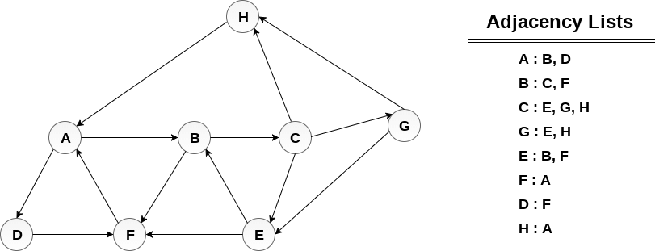
Algorithm
Step 1: SET STATUS = 1 (ready state) for each node in G
Step 2: Push the starting node A on the stack and set its STATUS = 2 (waiting state)
Step 3: Repeat Steps 4 and 5 until STACK is empty
Step 4: Pop the top node N. Process it and set its STATUS = 3 (processed state)
Step 5: Push on the stack all the neighbours of N that are in the ready state (whose STATUS
= | 1) |  | and | set | their
STATUS [END OF LOOP] |  | = | 2 | (waiting | state)
o Step 6: EXIT
Example :
Consider the graph G along with its adjacency list, given in the figure below. Calculate the order to print all the nodes of the graph starting from node H, by using depth first search (DFS) algorithm.
Solution :
Push H onto the stack
1. STACK : H

Slide 45
POP the top element of the stack i.e. H, print it and push all the neighbours of H onto the stack that are is ready state.
Print H
STACK : A
Pop the top element of the stack i.e. A, print it and push all the neighbours of A onto the stack that are in ready state.
Print A
Stack : B, D
Pop the top element of the stack i.e. D, print it and push all the neighbours of D onto the stack that are in ready state.
Print D
Stack : B, F
Pop the top element of the stack i.e. F, print it and push all the neighbours of F onto the stack that are in ready state.
Print F
Stack : B
Pop the top of the stack i.e. B and push all the neighbours
Print B
Stack : C
Pop the top of the stack i.e. C and push all the neighbours.
Print C
Stack : E, G
Pop the top of the stack i.e. G and push all its neighbours.
Print G
Stack : E

Slide 46
Pop the top of the stack i.e. E and push all its neighbours.
Print E
Stack :
Hence, the stack now becomes empty and all the nodes of the graph have been traversed. The printing sequence of the graph will be :
H → A → D → F → B → C → G → E
Algorithm
  Push starting vertex & print
  While( stack not empty) {
  P = top()
  Push (print) only one adjacent unvisited vertex of P
  If no valid vertext available pop() }

